Slide 1



Spatially-Resolved Transport Parameters in Solar Flares
Brian O’Donnell
Dale Gary, Gregory Fleishman, Bin Chen
NJIT – Center For Solar Terrestrial Research
SPD - 2023

Slide 2
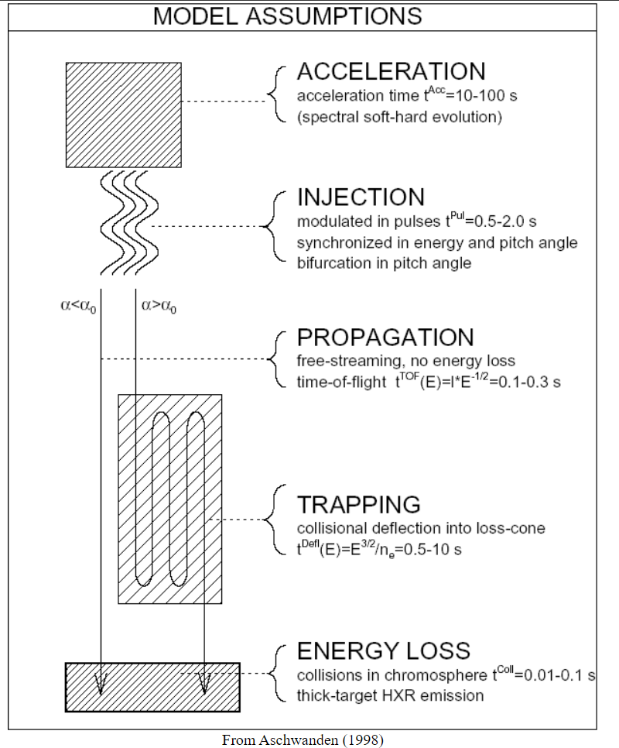
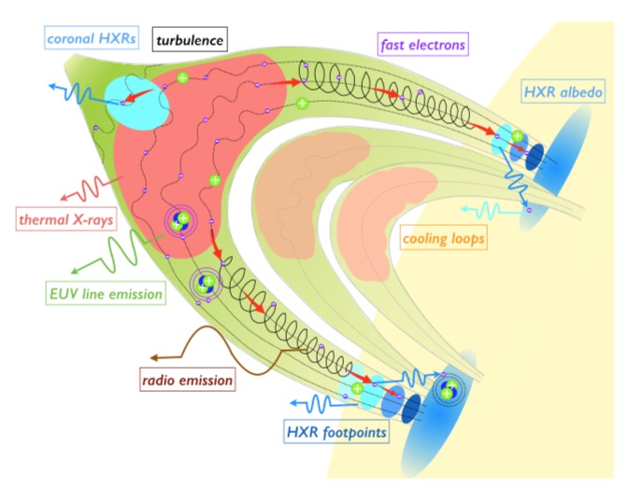

Injection-Precipitation Model of Flare Emissions
Youtube: @mrg3 Animations for Physics and Astronomy
Kontar et al 2017

Slide 3
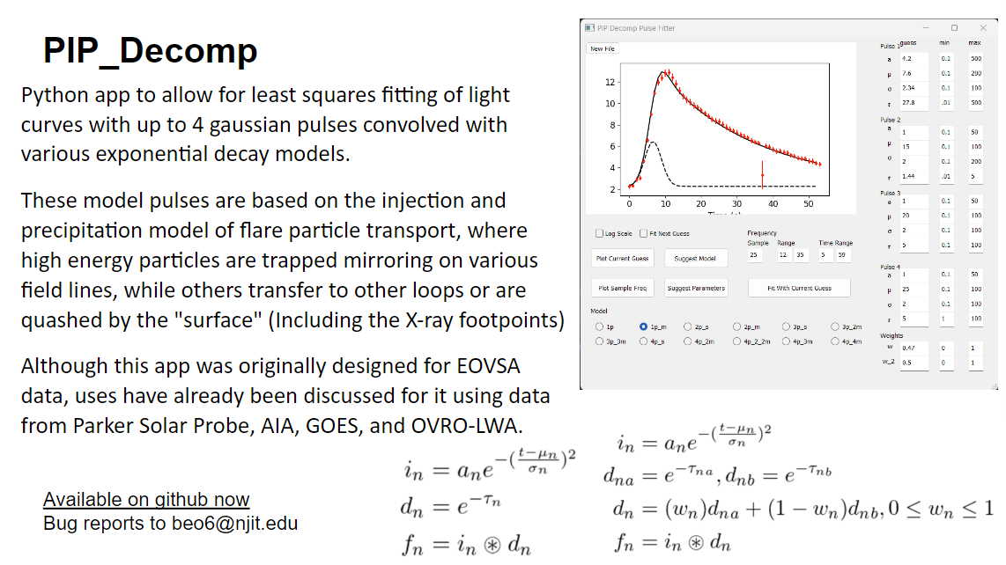
Giving fits key parameters that can be intuitively physically interpreted, in seconds!
Treating each frequency’s light curve independently
It can fit 12 models against a sample curve then fit the whole spectra with a guessed model in 3-clicks!

Slide 4
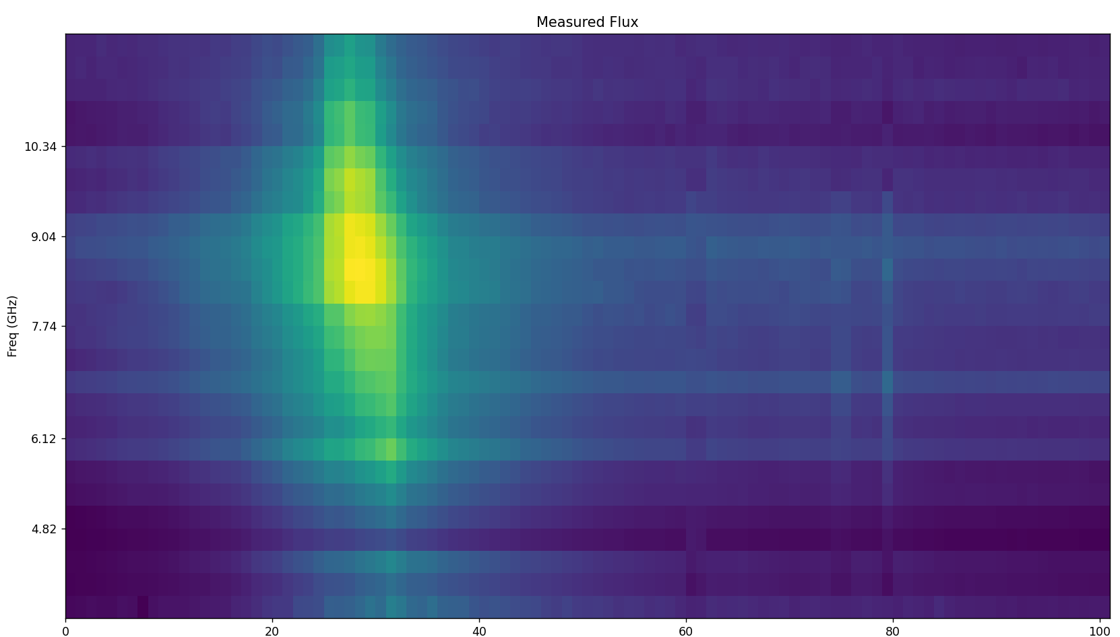
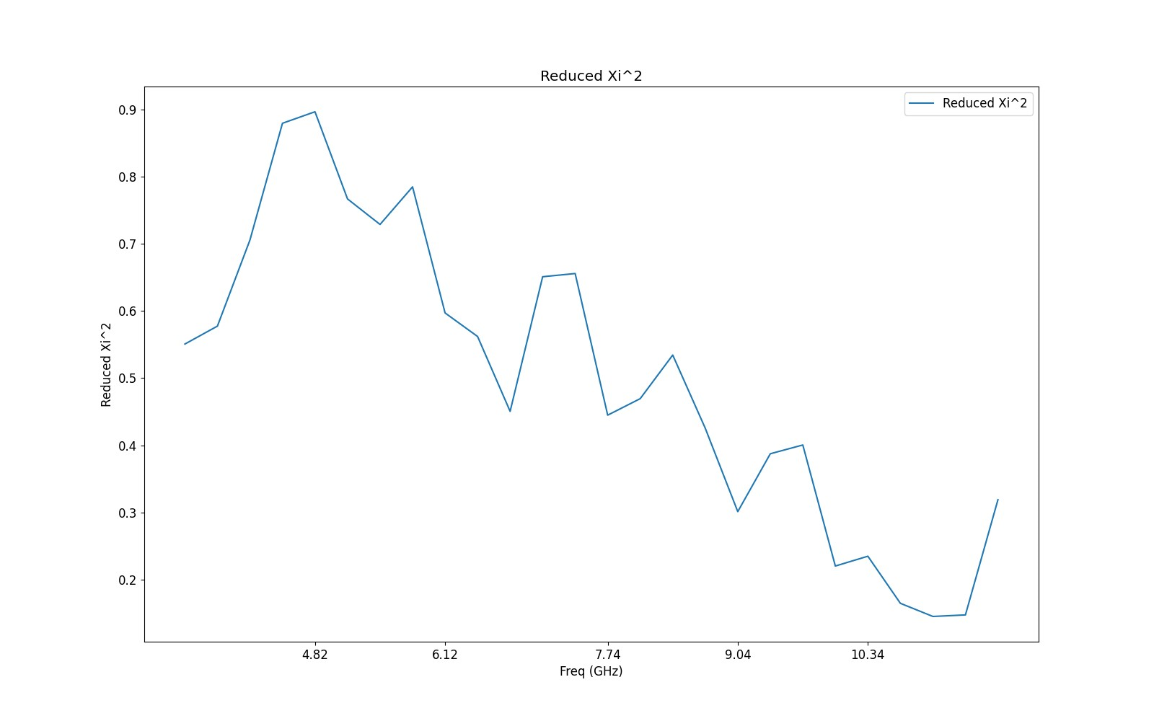
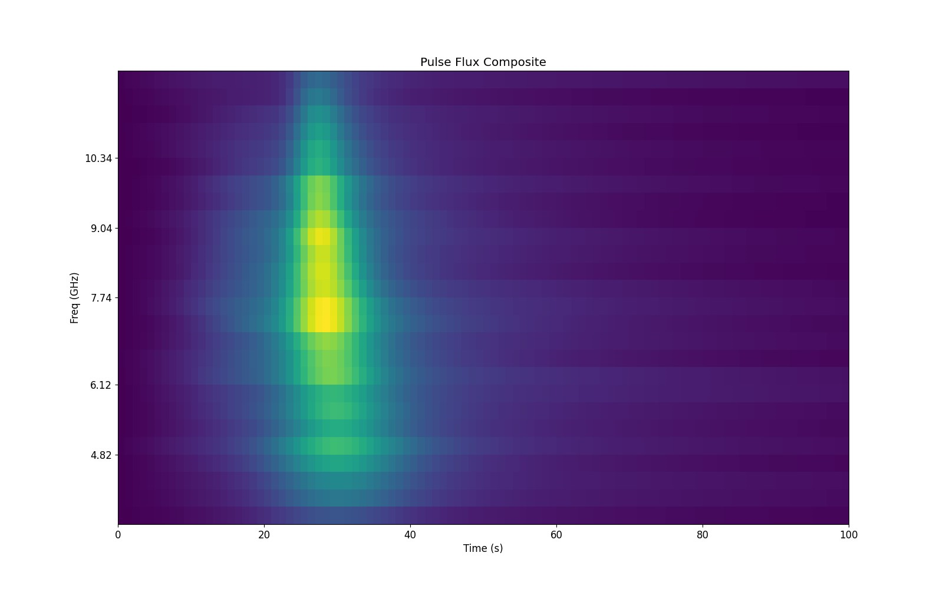
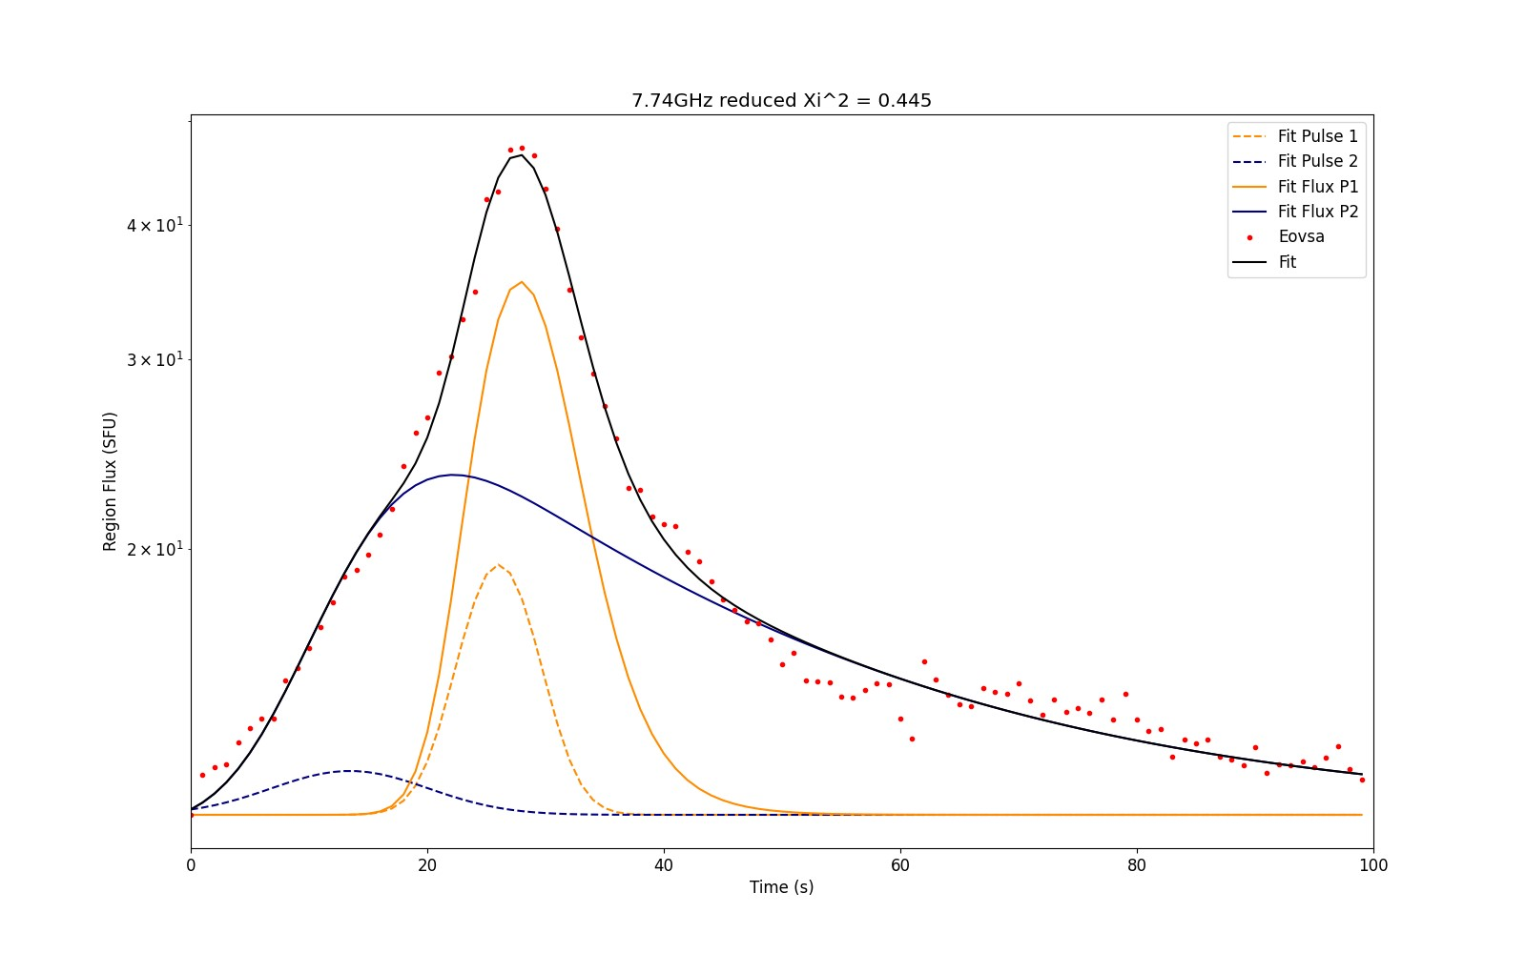
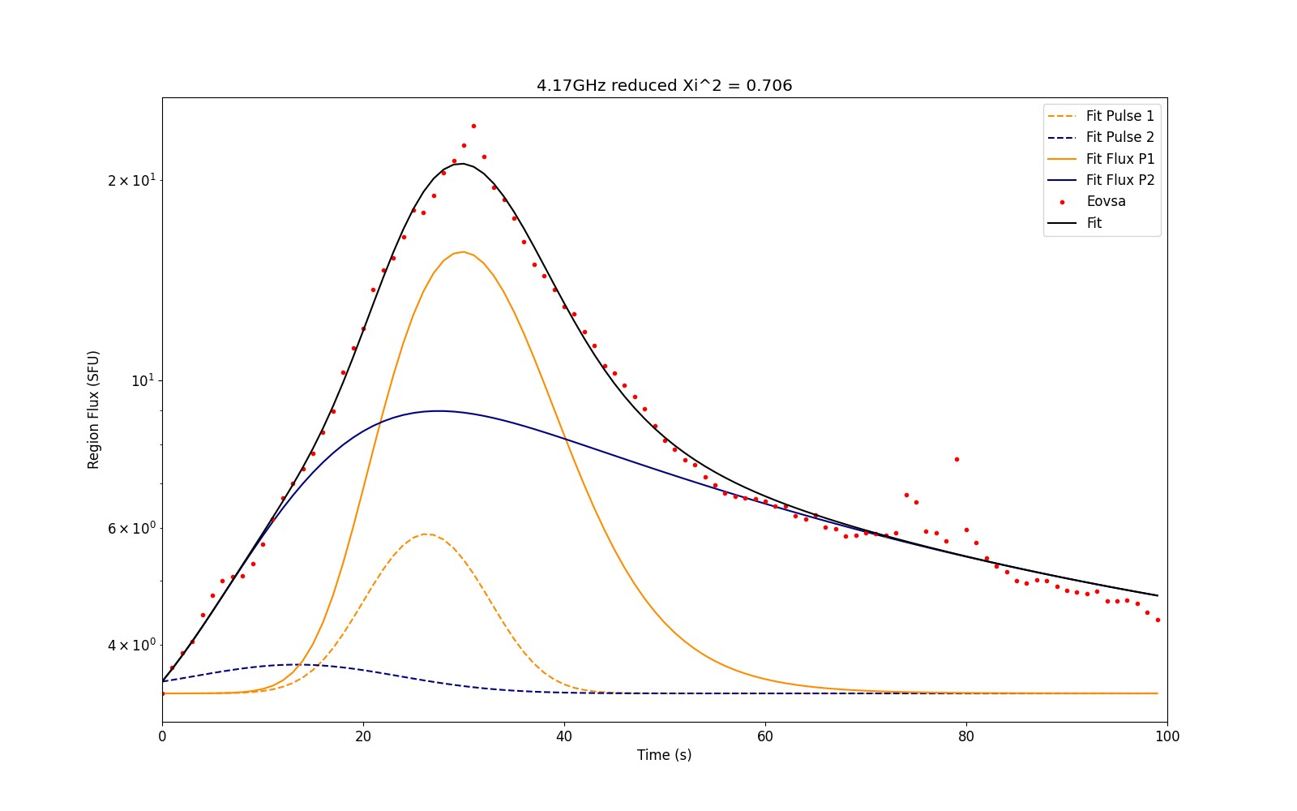
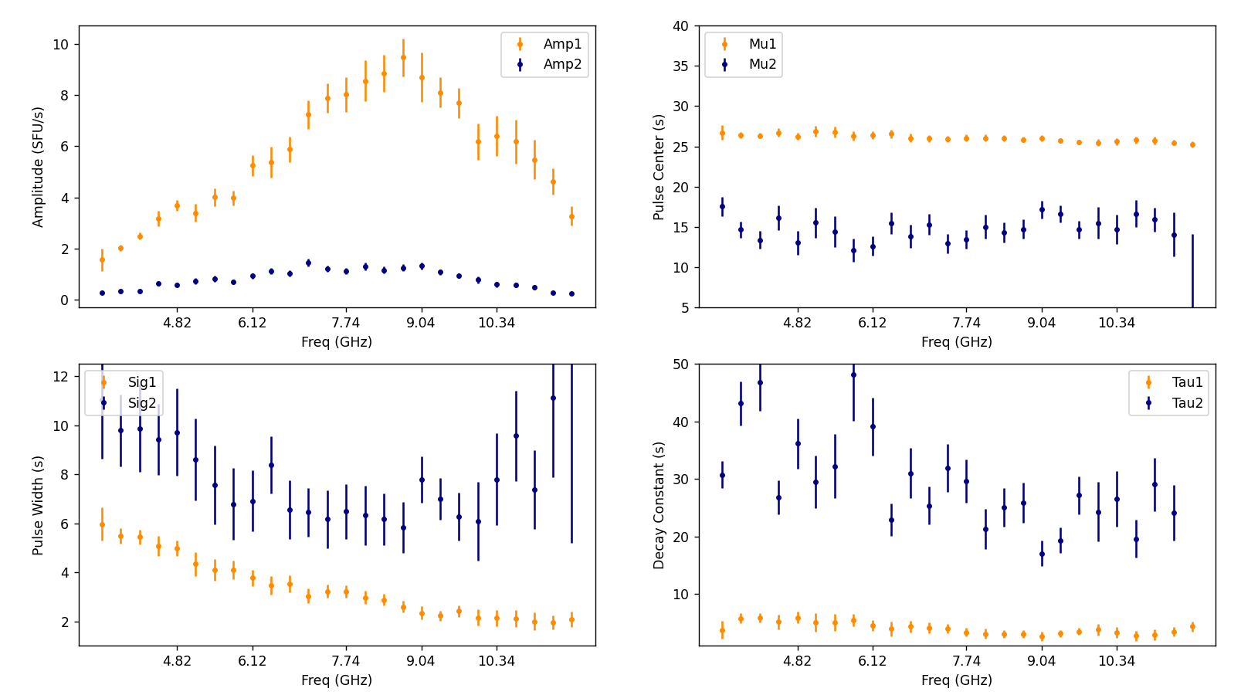
12/27/22 ~20:36
C4.5 / peak radio flux 30 sfu
Fit as 2 separate pulses
Measured Flux composite
Some spectra
Parameters appear

Slide 5
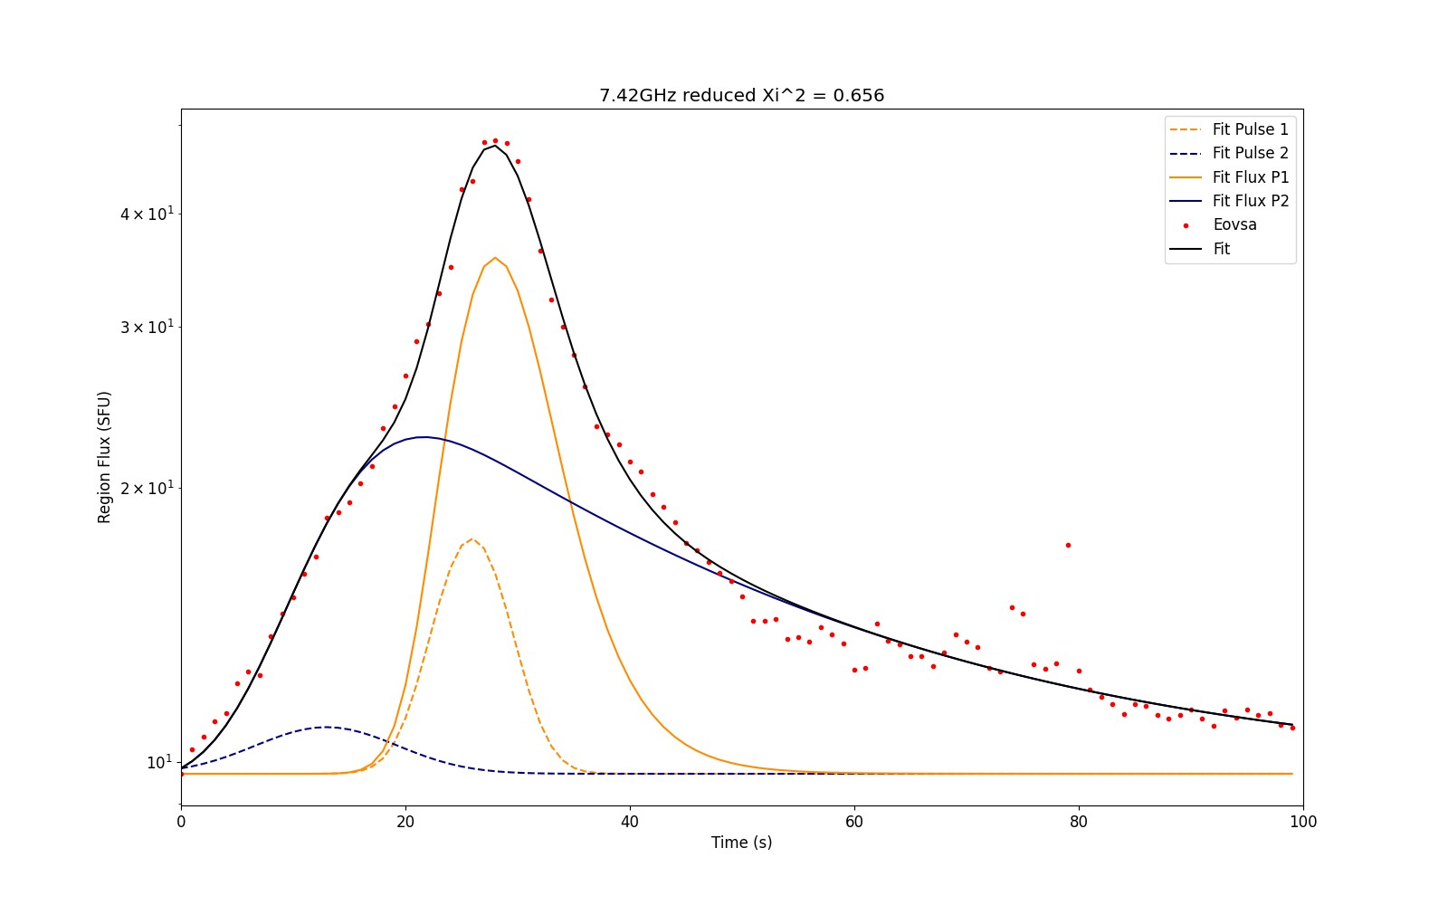
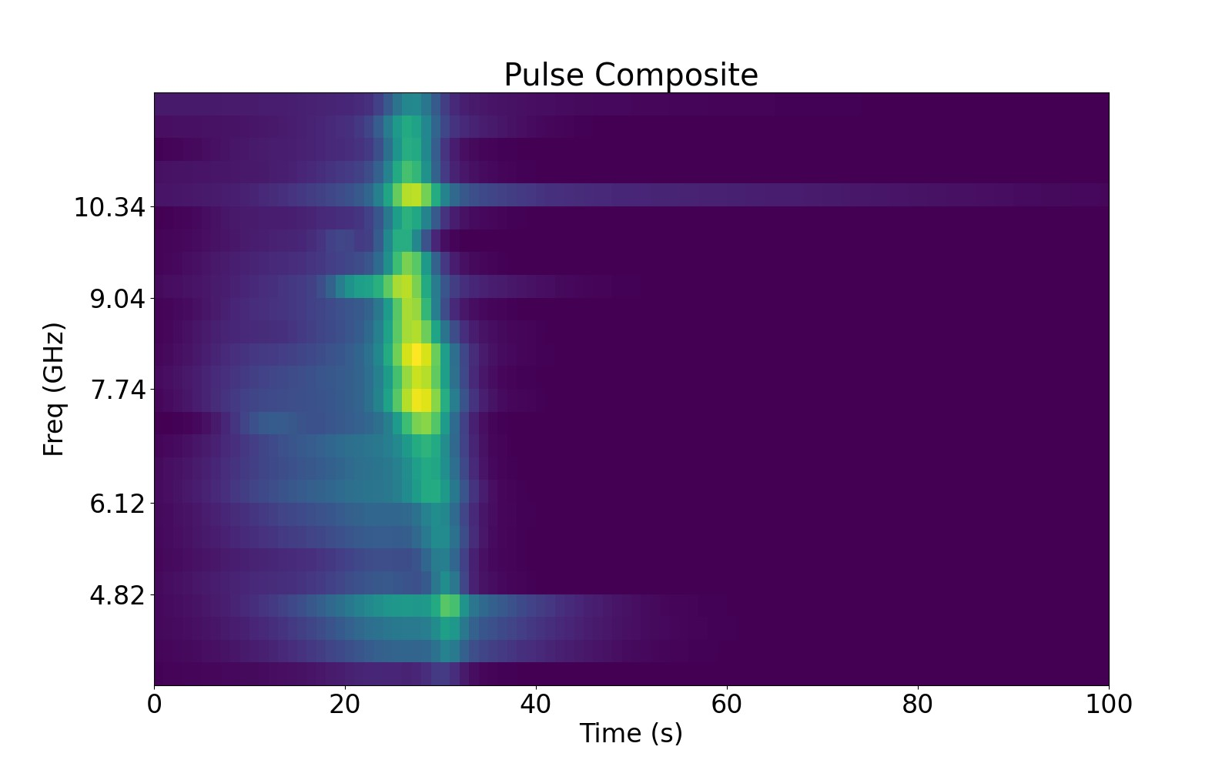
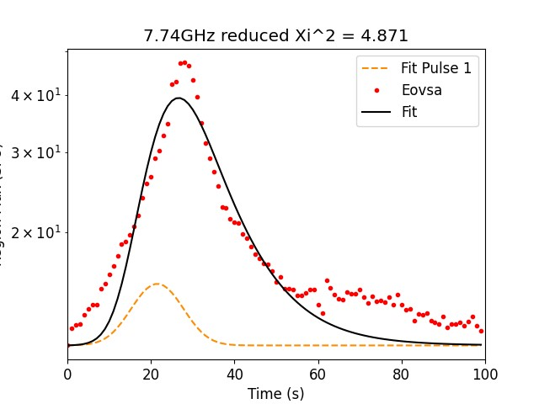
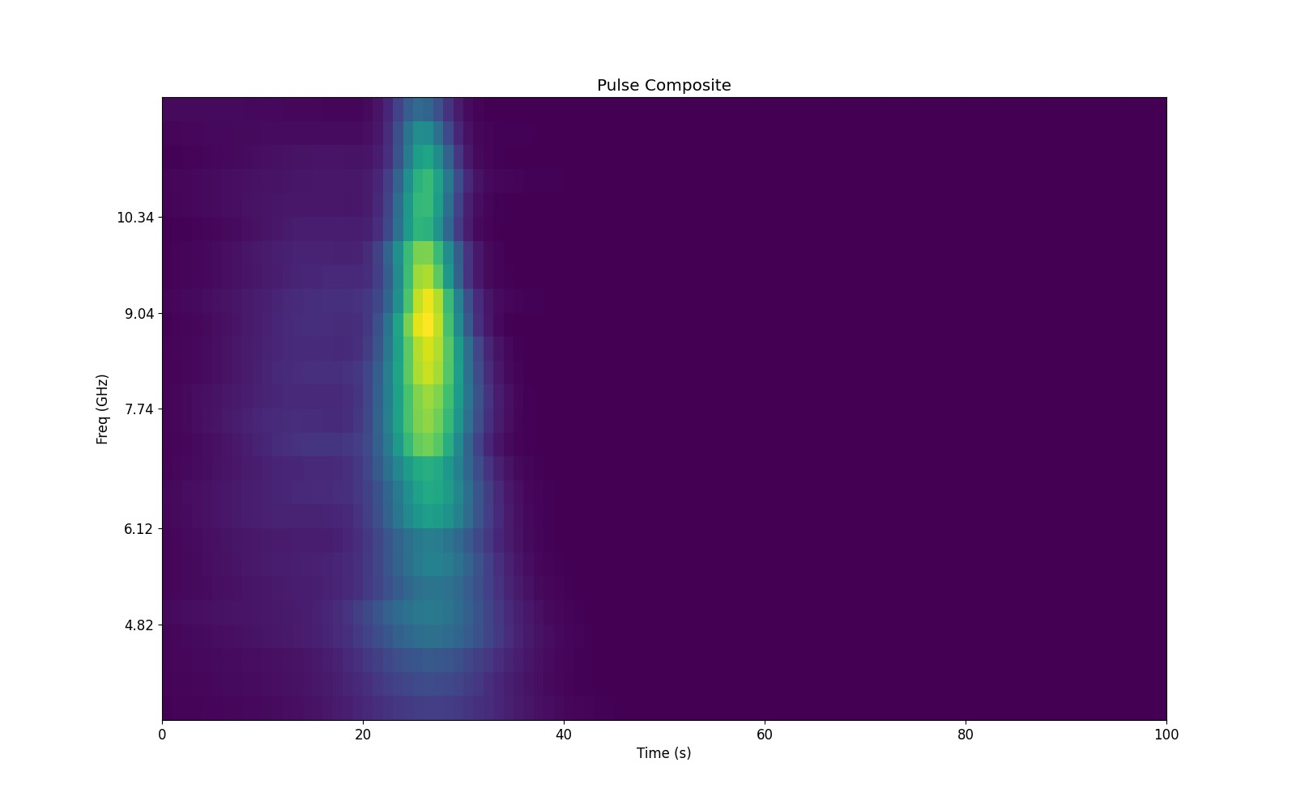
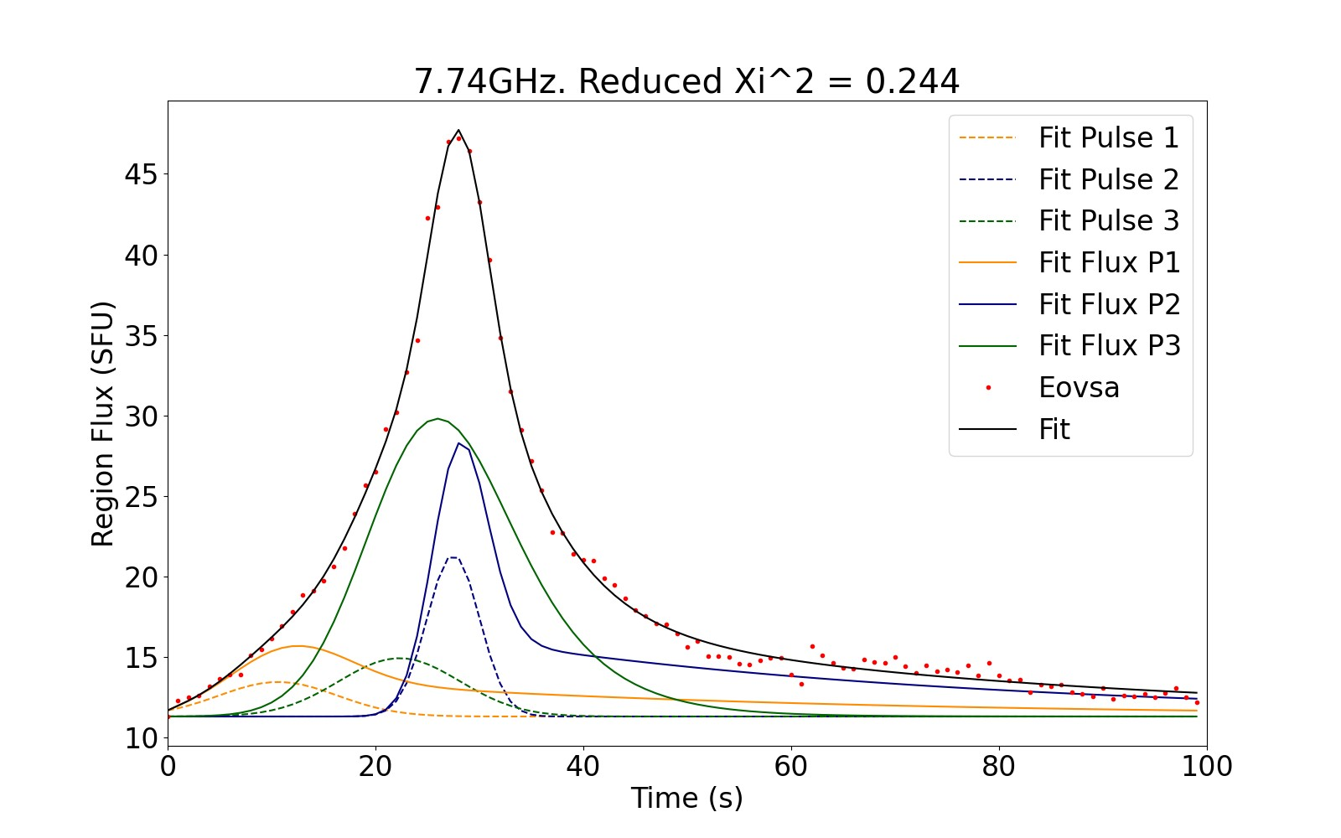
Warning: The app will fit whatever you ask with whatever you ask!
You are the physicist; it is a least squares fitter (with 4-18 Parameters to play with).
You are much smarter than it is! And, it has loads of local minima to fall into!
You should value reported reduced χ², and parameters errors,
but also, continuity, stability to change in initial guess, and “reasonableness”

Slide 6
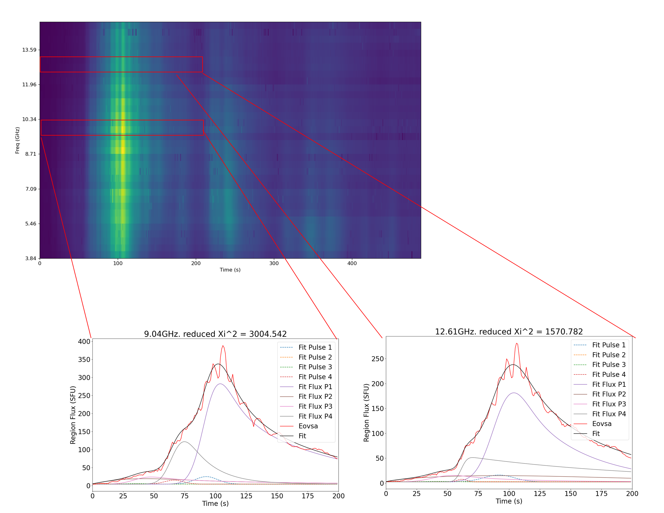
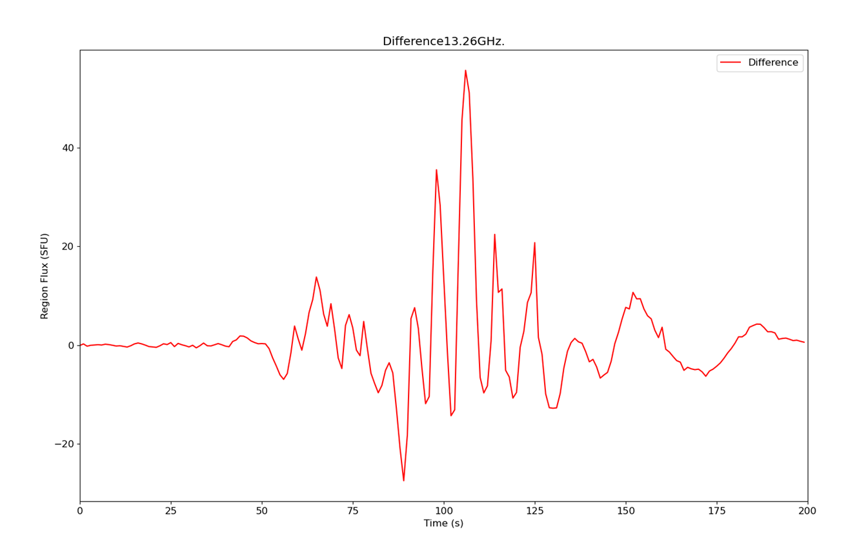
3/30/22
The oscillation make it imposable to get a close fit with only 4 impulses
But we can still extract meaningful info
Best fit with 4 pulses, 3 with mixed decays
Consider the difference of data and model,
a physically motivated detrending
that isolates the QPP structure in the data
(with no smoothing or splines)

Slide 7
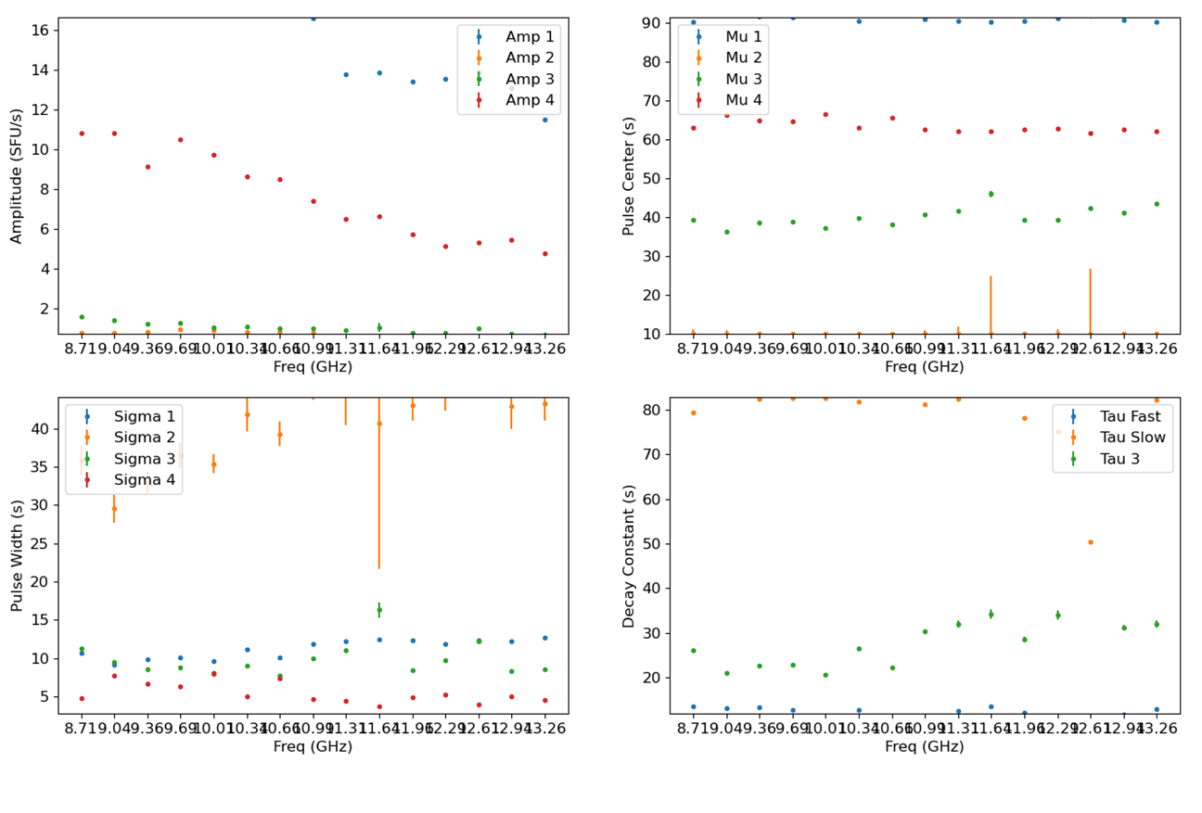
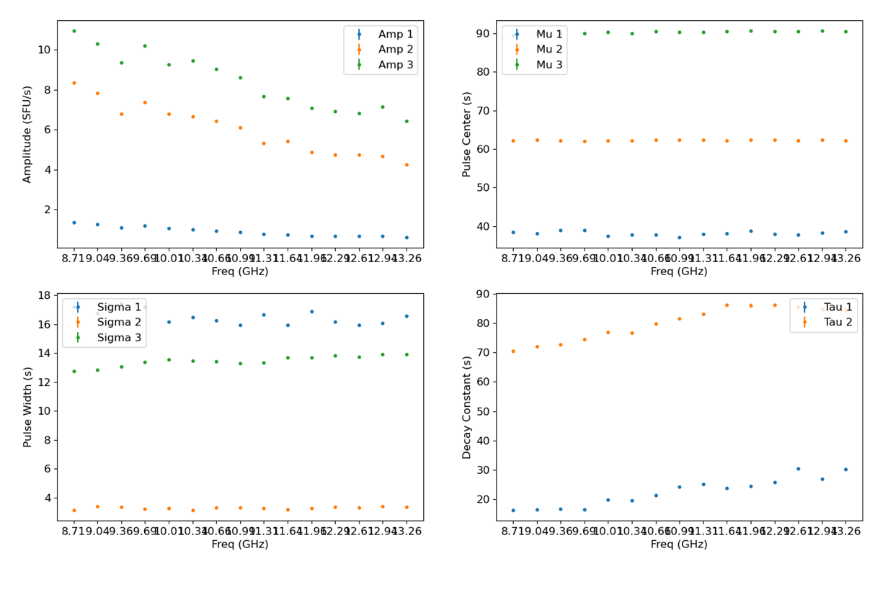
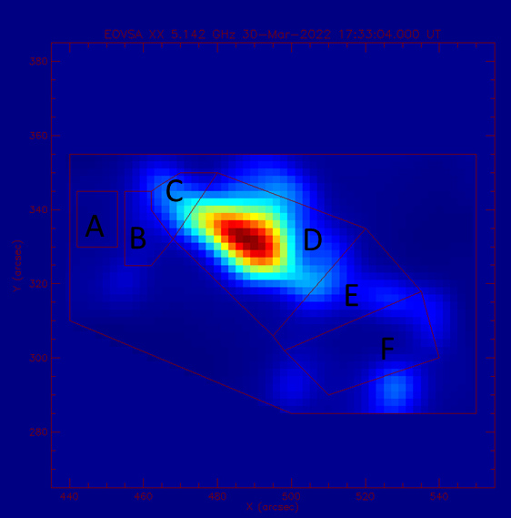
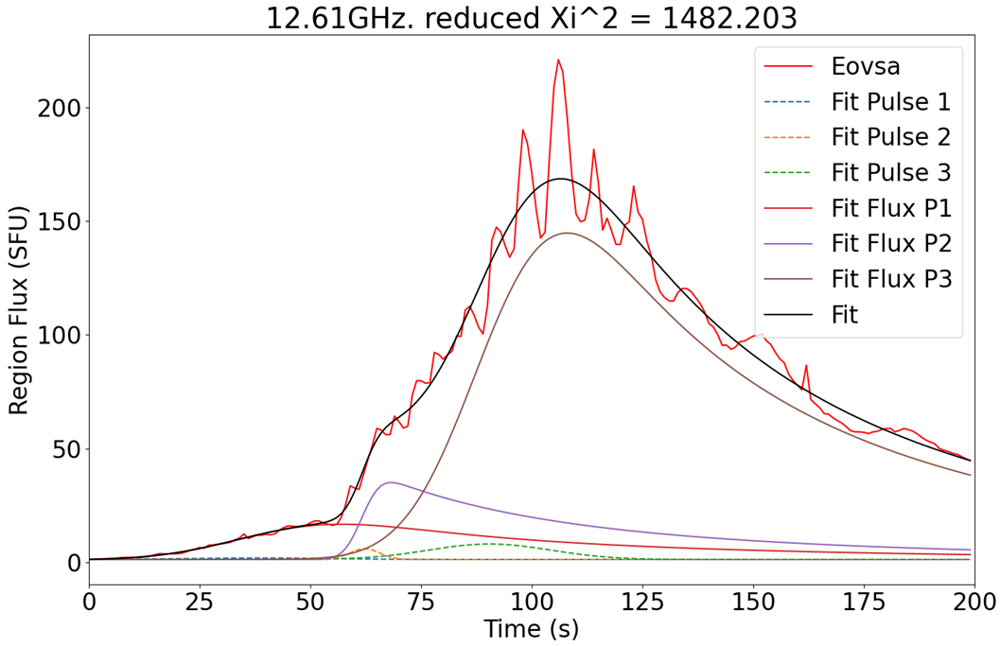
Spatial-Fitting
Spectral Imaging Capability Allows Spatial Fitting
Here the QPP is isolated to the D region
The D region fits as 3 pulses with mixed decays,
Parameters close to the 3 mixed pulses in the full fit
Dynamic range issues push the oscillation into other boxes, but it seems to be truly localized here
Much more to do (like fit isolated the QPP spikes!)

Slide 8
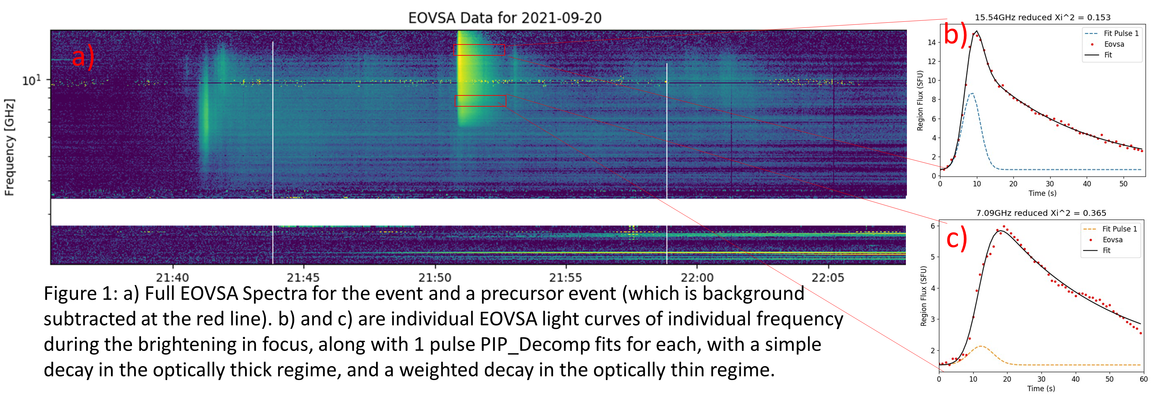
Transport and Trapping (?) in Spiky B-Class Flare on Sept 20, 2021

Slide 9
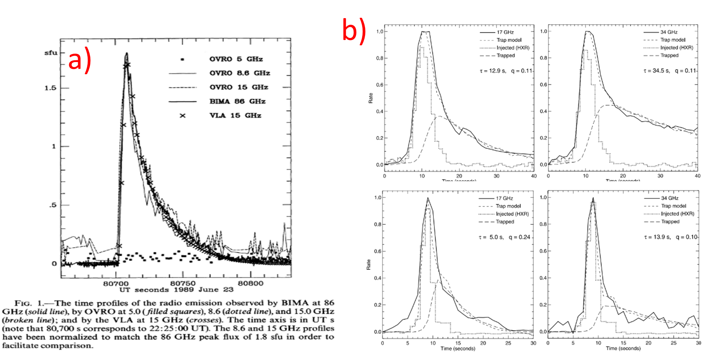
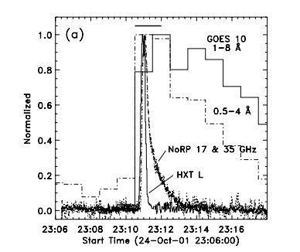
Previous Treatment of Similar Flares
These fast-starting broad frequency spikes modeled by Kundu et al and Bastion et al as an injection and trapping
Fast Rise/Exponential decay
In a compact loop over a neutral line
c) noted as especially x-ray poor
c)
White et al 1992
Kundu et al 2001
Bastion, Fleishman, and Gary 2007

Slide 10
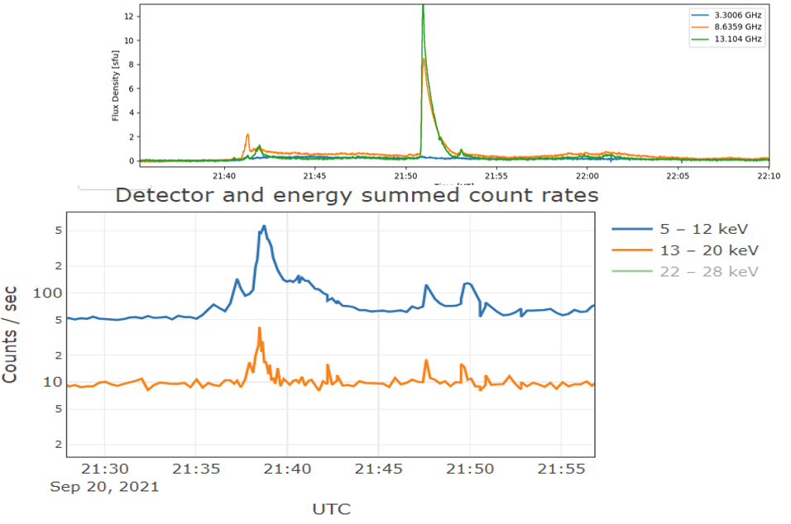
Quick STIX Comparison
STIX was at ~.6AU, so time difference ~3min
(sorry for the hand alignment!)
The Radio spike is very X-ray poor!

Slide 11
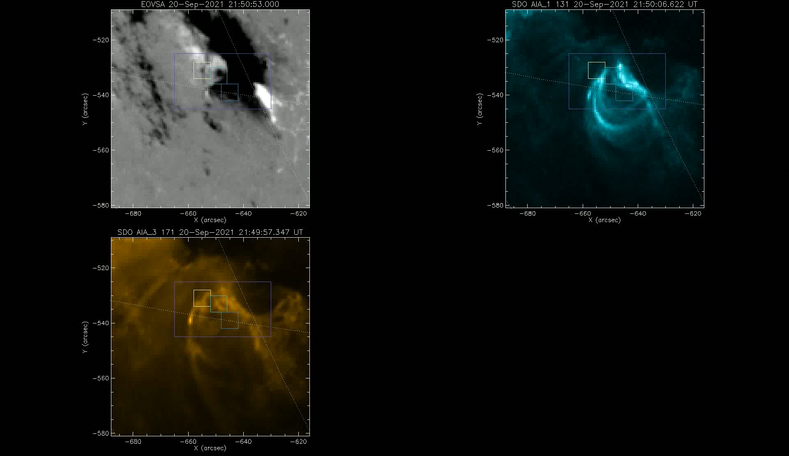

Slide 12
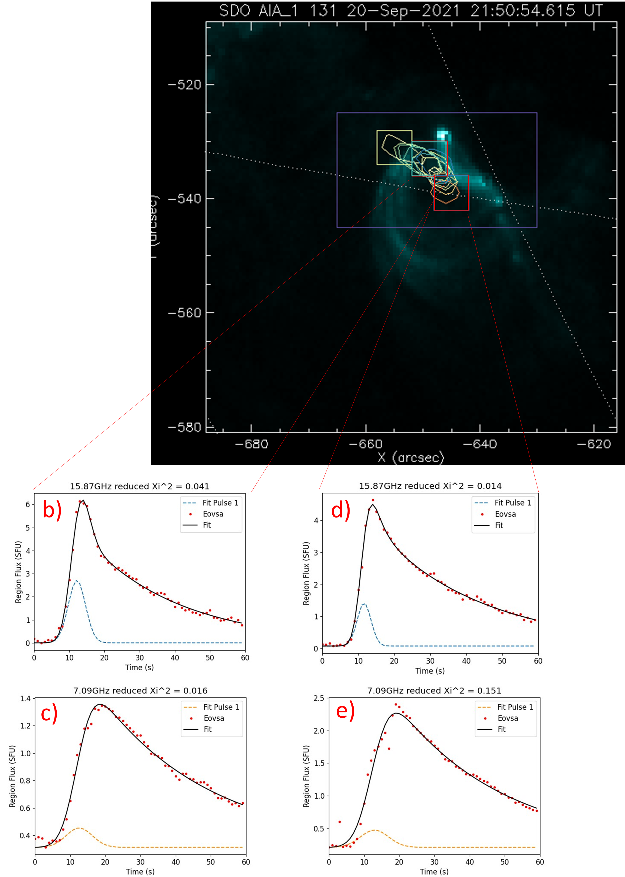
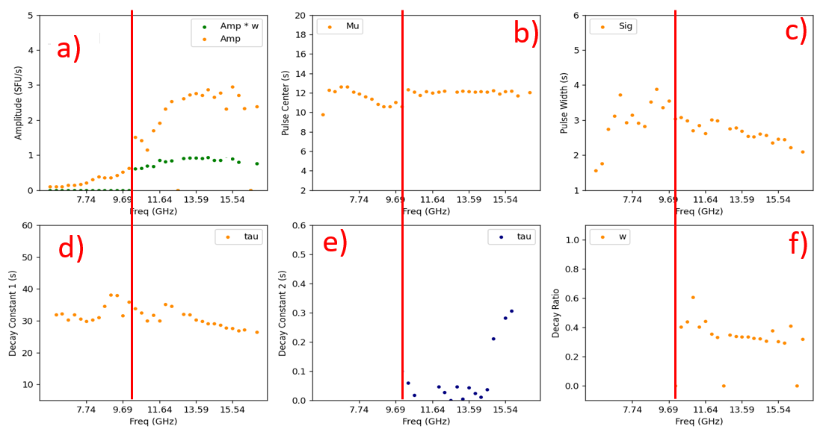
PIP_Decomp Fits
It fits so well I have to question my error measurement
Fit as a single gaussian injection
With a simple decay in the optically thick frequencies
And a mixed decay in the optically thin frequencies
Fitting box i) vs box ii) also shows very similar fits except
Box ii) injection is ~.5 second later
Box ii) amplitudes are higher for lower frequencies
i)
ii)

Slide 13
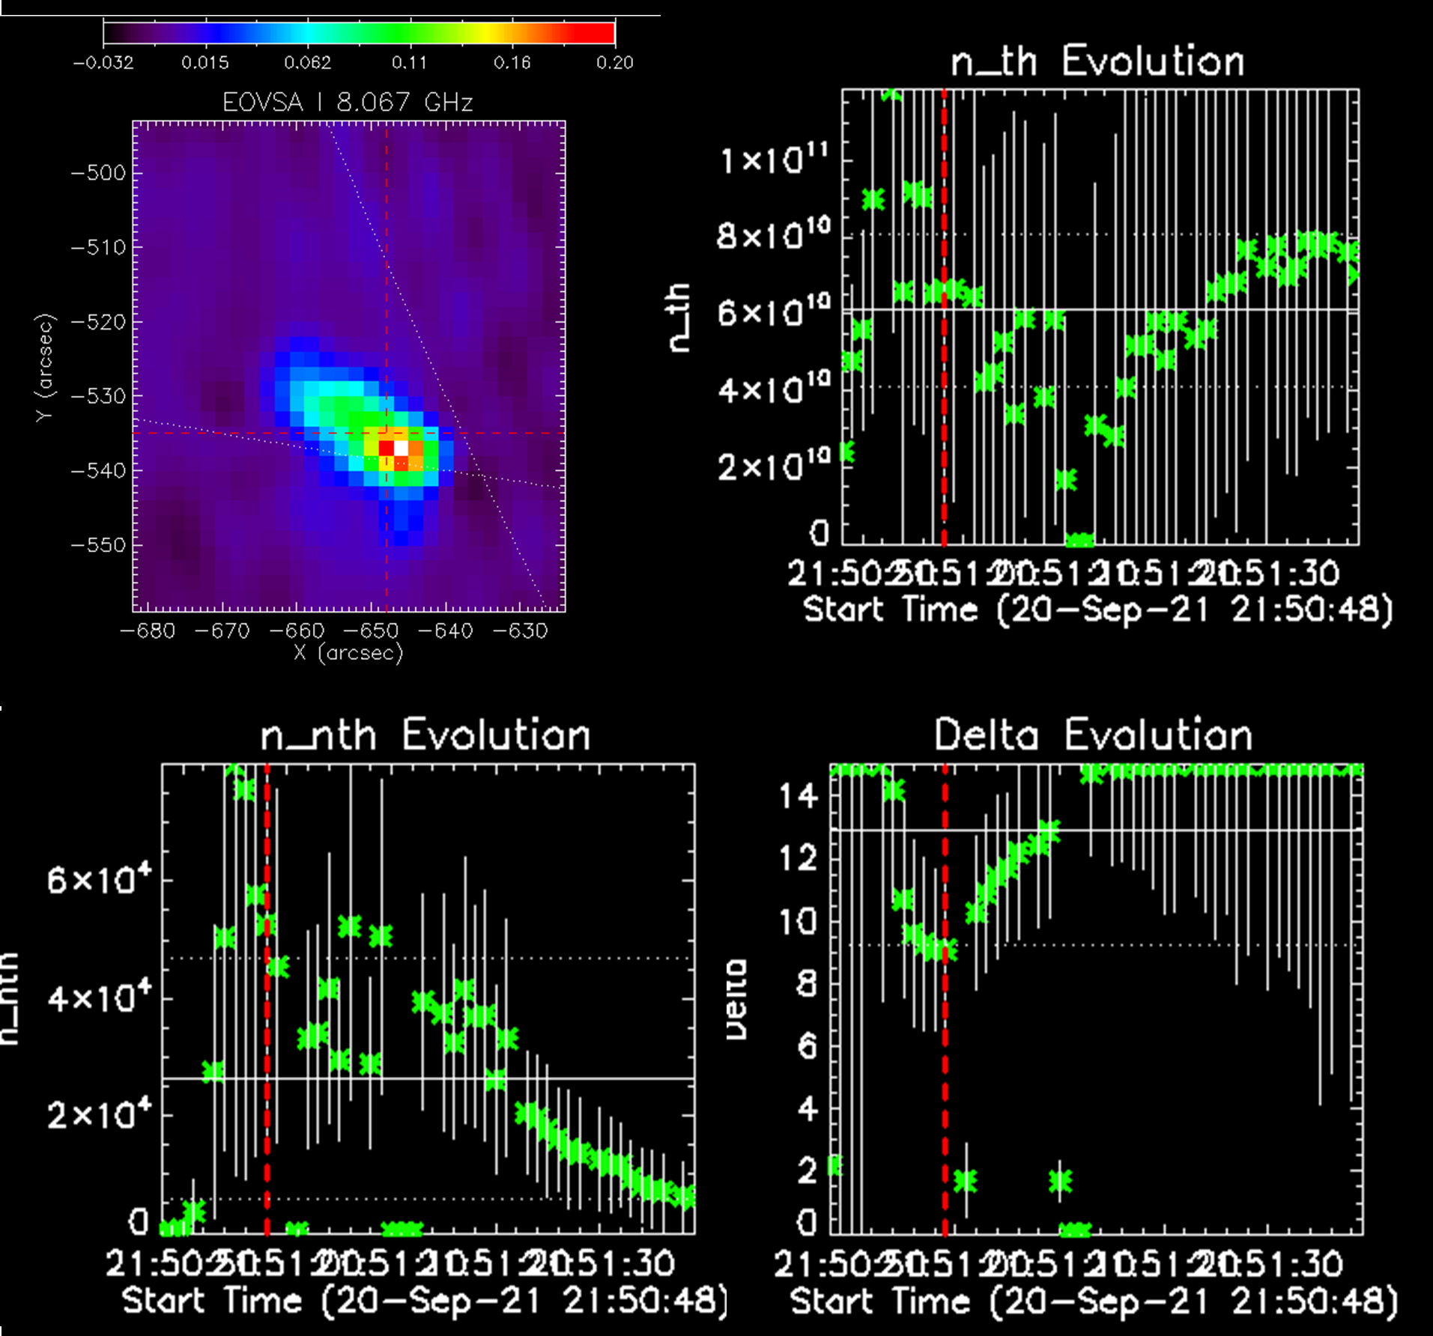
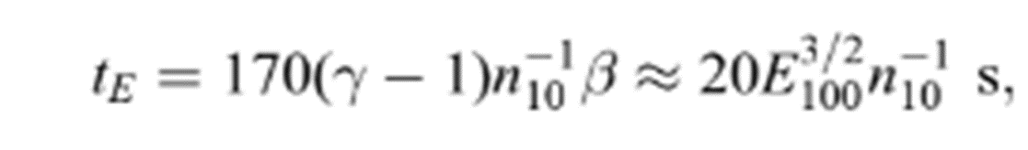
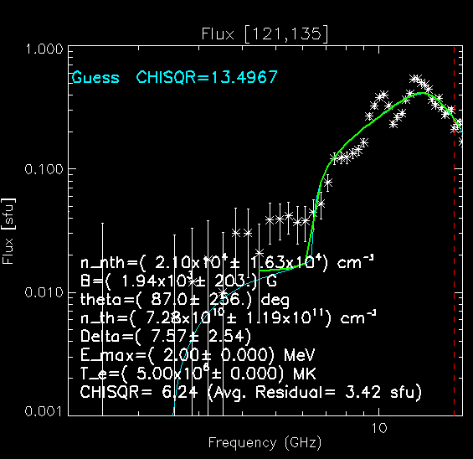
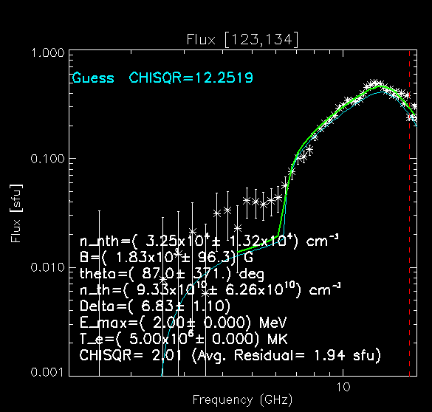
Except
The loop is too dense for 30s trapping, especially given the fit energy distribution
(Melrose & Brown 1976)
Considering 5 x 10¹⁰ - 10¹¹ density and E_max of ~2-3 MeV with minimum δ of ~7-8, t_E of the average electron is <1s

Slide 14
Conclusions/Questions
About This Flare
The simple magnetic trap model for spiky radio flares does not appear to appear to fit the plasma parameters of this flare
But for a class of small flares in compact loops, those parameters look rather normal
Is this a more complicated trapping mechanism?, Or is this a sort of rolling acceleration mechanism?
In General
I have a fast and easy tool for the community to quickly compare models and get reasonable parameters for injections
(or any ~mathematically equivalent spectra with an exponential decay)
I hope people use it

Slide 15

Thanks!
To the NSF for funding OVRO
To the NJIT-CSTR Team and the OVRO-LWA Team
Get PIP_Decomp and use it on your data!
Bug reports go to the me (beo6@njit.edu)
Docs to come soon

